Slide 1
Creating an Oracle Database

Slide 2
Objectives
After completing this lesson, you should be able to do the following:
Create a database by using the Database Configuration Assistant (DBCA)
Create a listener by using the Oracle Net Configuration Assistant (NetCA)
Create a database design template with the DBCA
Generate database creation scripts with the DBCA

Slide 3
Planning the Database
As a DBA, you must plan:
The logical storage structure of the database and its physical implementation:
How many disk drives do you have? What type of storage is being used?
How many data files will you need? (Plan for growth.)
How many tablespaces will you use?
What types of information will be stored?
Are there any special storage requirements due to type or size?
Overall database design
Database backup strategy
Notes:
Planning the Database
It is important to plan how the logical storage structure of the database will affect system performance and various database management operations. For example, before creating any tablespaces for your database, you should know how many data files will make up the tablespace, what type of information will be stored in each tablespace, and on which disk drives the data files will be physically stored. Information such as the availability of network attached storage (NAS) and the bandwidth for the private storage network are important. If storage area networks (SAN) are going to be used, knowing how the logical volumes are configured and the stripe size is essential.
When planning the overall logical storage of the database structure, take into account the effects that this structure will have when the database is actually created and running. You may have database objects that have special storage requirements due to type or size.
In distributed database environments, this planning stage is extremely important. The physical location of frequently accessed data dramatically affects application performance.
During the planning stage, develop a backup strategy for the database. You can alter the logical storage structure or design of the database to improve backup efficiency. Backup strategies are introduced in a later lesson.

Slide 4
Databases: Examples
Data warehouse:
Research and marketing data
State or federal tax payments
Professional licensing (doctors, nurses, and so on)
Transaction processing:
Store checkout register system
Automatic teller machine (ATM) transactions
General purpose:
Retail billing system (for example, for a software house or a nursery)
Notes:
Databases: Examples
Different types of databases have their own specific instance and storage requirements. Your Oracle database software includes templates for the creation of these different types of databases. Characteristics of these examples are the following:
Data warehouse: For storing data for long periods and retrieving them in read operations
Transaction processing: For accommodating many (usually small) transactions
General purpose: For working with transactions and storing them for a medium length of time
The information on this page and the previous one present considerations that you will encounter as a DBA. This course (in its entirety) is designed to help you address them.

Slide 5
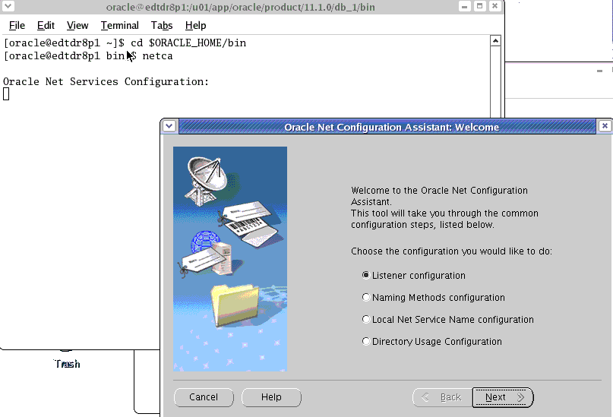
Configuring the Listener
Notes:
Configuring the Listener
When an instance starts, a listener process establishes a communication pathway to Oracle Database. When a user process makes a connection request, the listener determines whether it should use a shared server dispatcher process or a dedicated server process, and establishes an appropriate connection.
The listener also establishes a communication pathway between databases. When multiple databases or instances run on one computer, as in Oracle Real Application Clusters, service names enable instances to register automatically with other listeners on the same computer. A service name can identify multiple instances, and an instance can belong to multiple services. Clients connecting to a service do not need to specify which instance they require.
A listener has to be configured prior to configuring EM using DBCA. The Oracle Net Configuration Assistant (NetCA) is a simple tool for configuring the listener. The NetCA enables you to configure the listening protocol address and service information for an Oracle database. Use the NetCA for initial network configuration after database installation.

Slide 6
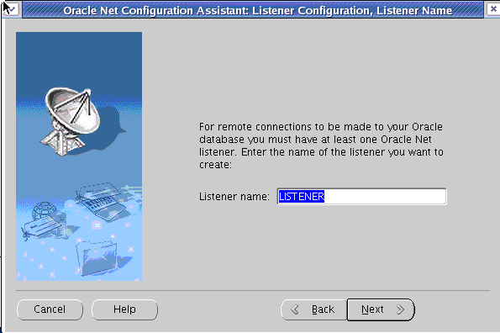
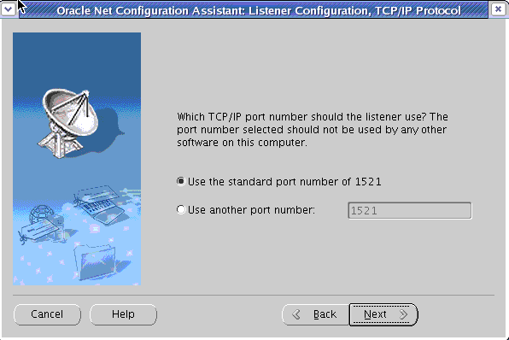
Configuring the Listener
Notes:
Configuring the Listener (continued)
1. Start netca from a command prompt.
2. Select Listener Configuration.
3. When prompted, enter the name of the listener.
4. Specify the port number for the listener.

Slide 7
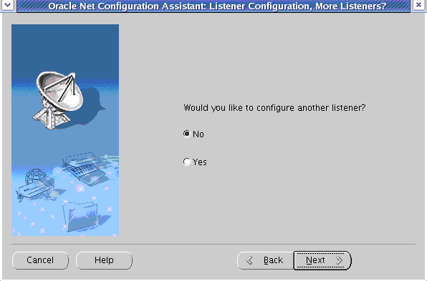
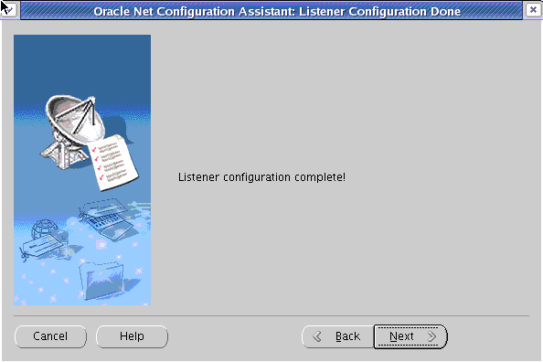
Configuring the Listener
Notes:
Configuring the Listener (continued)
5. Select No when you are asked if you want to configure another listener. Your listener configuration is complete.
You are now ready to begin database creation by using the DBCA.

Slide 8
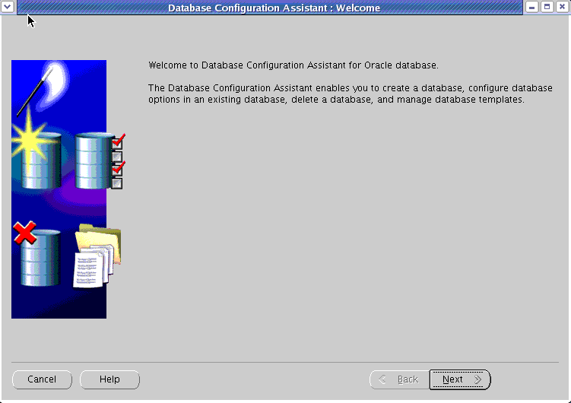
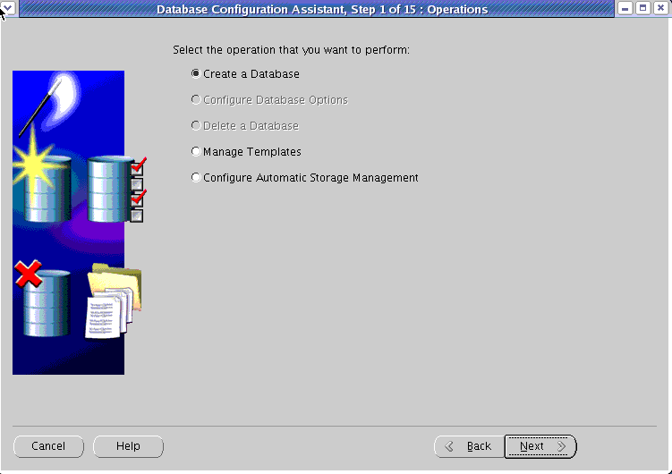
Database Configuration Assistant (DBCA)
1
Notes:
Database Configuration Assistant (DBCA)
You can use the Database Configuration Assistant (DBCA) to create, change the configuration of, or delete a database. You can also create a database from a list of predefined templates or use an existing database as a sample to create a new database or template. This is sometimes referred to as “database cloning.”
To invoke the DBCA:
1. Log on to your computer as a member of the OS DBA group that is authorized to install the Oracle software.
2. If required, set environment variables.
3. Enter dbca to invoke the DBCA.
4. Click Next to continue.
DBCA offers you a choice of assisting with several operations (for example, creating a database).

Slide 9
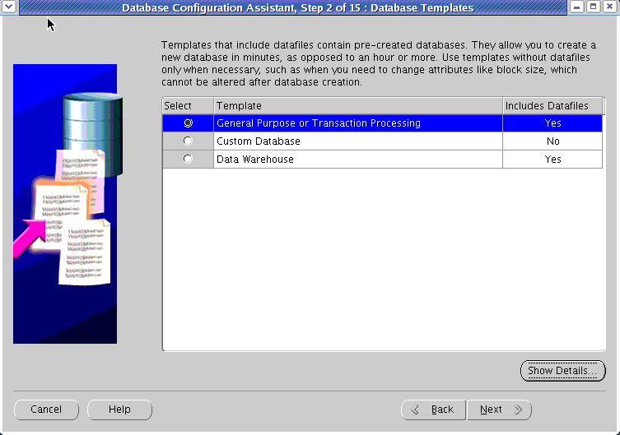
Using the DBCA to Create a Database
2
Notes:
Using the DBCA to Create a Database
To use the DBCA to create a database:
1. Select “Create a Database” on the DBCA Operations page to invoke a wizard that enables you to configure and create a database.
The wizard prompts you to provide configuration information (as outlined in the steps that follow). On most pages, the wizard provides a default setting that you can accept.
2. Select the type of database template to be used in creating the database. There are templates for Data Warehouse, General Purpose, and Transaction Processing databases that copy a preconfigured database, including data files. These data files include control files, redo log files, and data files for various included tablespaces. Click Show Details to see the configuration for each type of database. For more complex environments, you may want to select the Custom Database option.

Slide 10
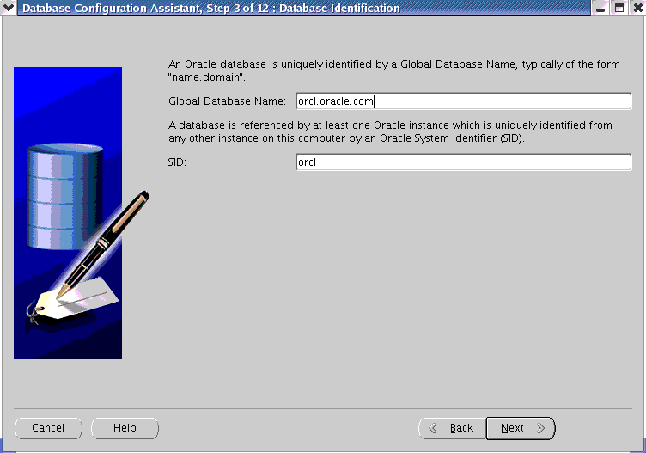
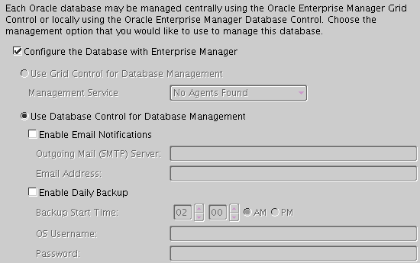
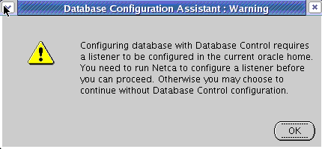
Using the DBCA to Create a Database
3
4
Notes:
Using the DBCA to Create a Database (continued)
3. Database Identification: Enter the Global Database Name in the form database_name.domain_name, and the system identifier (SID). The SID defaults to the database name and uniquely identifies the instance associated with the database.
4. Management Options: Use this page to set up your database so that it can be managed with Oracle Enterprise Manager. Select the default: “Configure the Database with Enterprise Manager.”
Note: You must configure the listener before you can configure Enterprise Manager (as shown earlier).

Slide 11
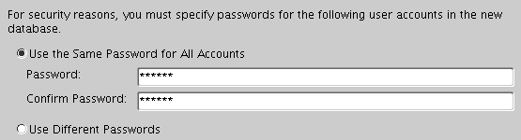
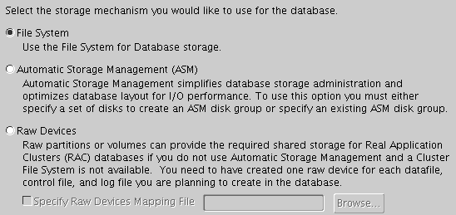
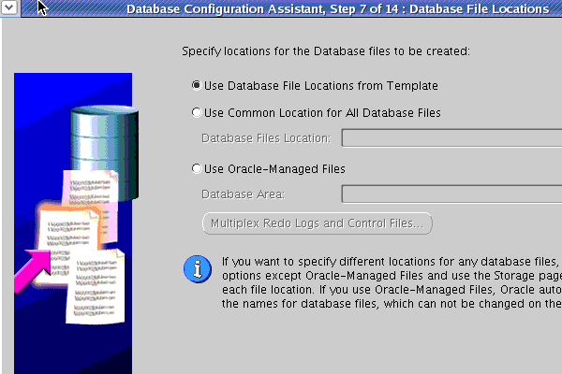
Using the DBCA to Create a Database
5
6
7
Notes:
Using the DBCA to Create a Database (continued)
5. Database Credentials: Use this page to specify the passwords for the administrative accounts, such as SYS and SYSTEM. In class, use oracle as the password for all administrative accounts.
6. Storage Options: Specify the type of storage mechanism (such as File System) that you want your database to use.
7. Database File Locations: Choose according to your needs. Using Oracle Managed Files (OMF) eliminates the need for you to directly manage the operating system files in an Oracle database. You specify operations in terms of database objects rather than file names. For details, see the lesson titled “Managing Database Storage Structures.”

Slide 12
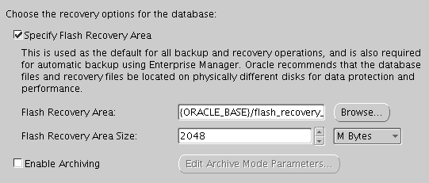
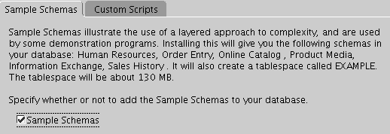
Using the DBCA to Create a Database
8
9
Notes:
Using the DBCA to Create a Database (continued)
8. Recovery Configuration: If required, specify a flash recovery area and enable archiving.
9. Database Content: These pages provide options for selecting components (such as Sample Schemas) and using custom scripts.

Slide 13
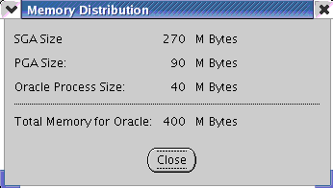
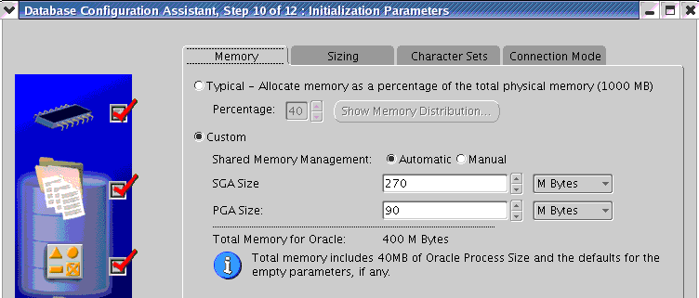
Using the DBCA to Create a Database
A
10
B
Notes:
Using the DBCA to Create a Database (continued)
10. Initialization Parameters: The tabs on this page provide access to pages that enable you to change default database settings:
Memory: Use this page to set the initialization parameters that control memory usage. Use either (A) Typical or (B) Custom memory allocation.
Sizing: To specify block size, enter the size in bytes or accept the default.
Character Sets: Use this page to specify the character sets for your database.
Best Practice Tip: Oracle Corporation recommends (whenever possible) that you use Unicode for a database character set because it provides optimal flexibility for supporting Web technologies as well as many spoken languages.
Connection Mode: Select Dedicated or Shared Server Mode. For more details, see the lesson titled “Configuring the Oracle Network Environment.”
Note: Several initialization parameters are set for the lifetime of a database, such as the DB_BLOCK_SIZE and CHARACTER_SET parameters.

Slide 14
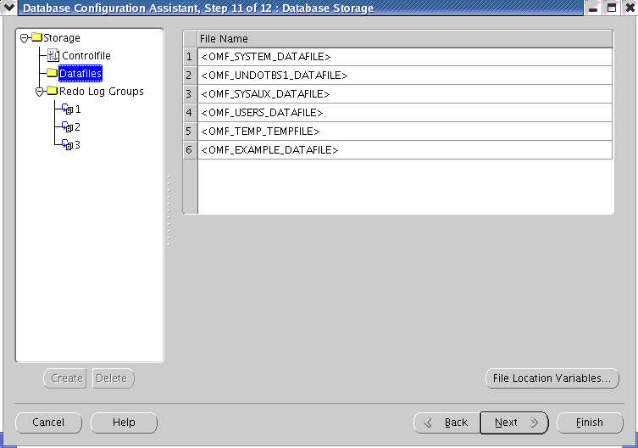
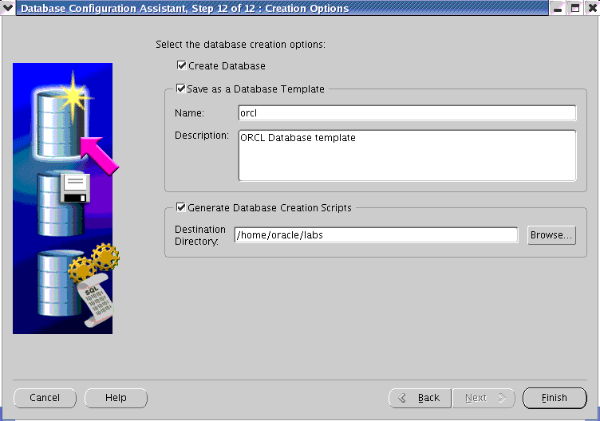
Using the DBCA to Create a Database
11
12
Notes:
Using the DBCA to Create a Database (continued)
11. Database Storage: If you selected one of the preconfigured templates for a database, you cannot add or remove control files or data files.
Note: You may want to save your database definition as an HTML file for easy reference.
12. Creation Options: You have the following options: create your database at this time, save the database definition as a template, and generate scripts. If you choose all options, the DBCA first saves the database template, then generates the scripts into your destination directory, and finally creates your database.

Slide 15
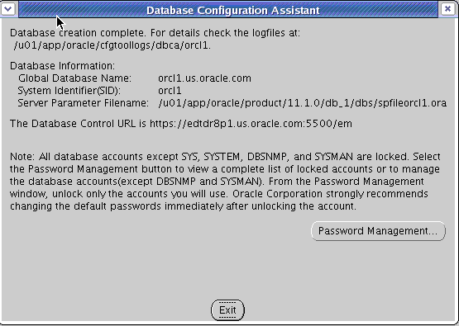
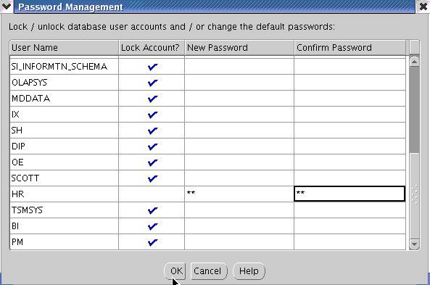
Password Management
Notes:
Password Management
After the DBCA finishes, note the following information for future reference:
Location of installation log files
Global database name
System identifier (SID)
Server parameter file name and location
Enterprise Manager URL
Click Password Management to unlock database accounts that you plan to use. Provide a password when you unlock an account.

Slide 16
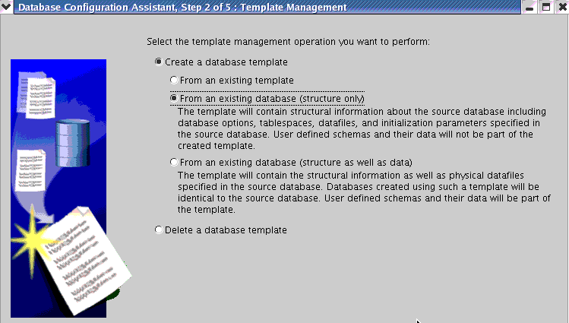
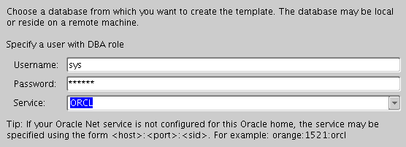
Creating a Database Design Template
Notes:
Creating a Database Design Template
A template is a predefined database definition that you use as a starting point for a new database. If you do not create a template as part of the database creation process, you can do it at any time by invoking the DBCA.
There are three ways to create a template:
From an existing template
From an existing database (structure only)
From an existing database (structure as well as data)
The DBCA guides you through the steps to create a database design template.

Slide 17
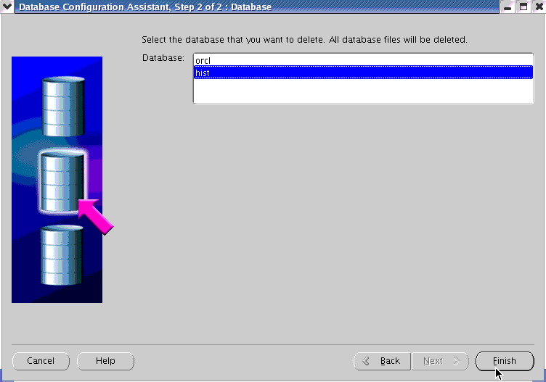
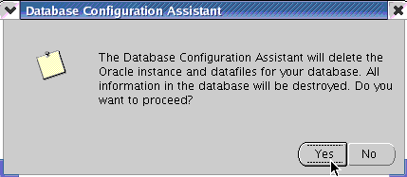
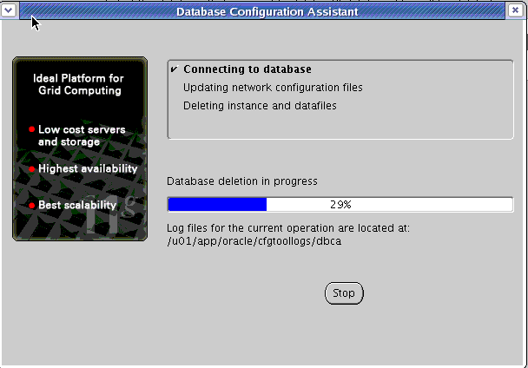
Using the DBCA to Delete a Database
1
2
Notes:
Using the DBCA to Delete a Database
To delete (or configure) a database in UNIX or Linux, you must set ORACLE_SID in the shell from which the DBCA is launched.
Start the DBCA by entering dbca in a terminal window, and click Next on the Welcome page. To delete the database, perform the following steps:
1. On the Operations page, select Delete a Database. Then click Next.
2. Select the database that you want to delete (in class, hist), and click Finish.
3. Click Yes to confirm your deletion.

Slide 18
Notes Only
Notes:
Using the DBCA to Delete a Database (continued)
Dropping a database involves removing its data files, redo log files, control files, and initialization parameter files. The DROP DATABASE statement deletes all control files and all other database files listed in the control file. To use the DROP DATABASE statement successfully, all of the following conditions must apply:
The database must be mounted and closed.
The database must be mounted exclusively (not in shared mode).
The database must be mounted as RESTRICTED.
An example of this statement is:
DROP DATABASE;
The DROP DATABASE statement has no effect on archived log files, nor does it have any effect on copies or backups of the database. It is best to use Recovery Manager (RMAN) to delete such files. If the database is on raw disks, the actual raw disk special files are not deleted.

Slide 19
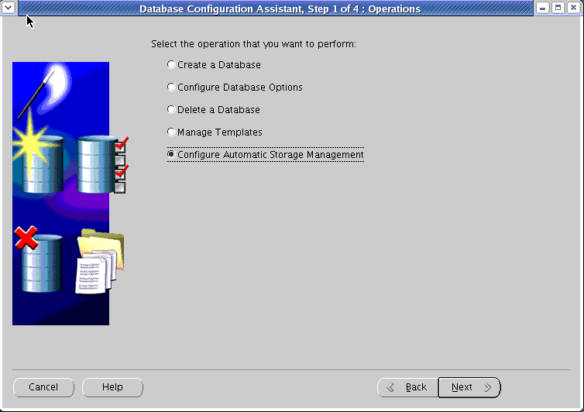
Using the DBCA for Additional Tasks
Notes:
Using the DBCA for Additional Tasks
You can use the DBCA to configure for Automatic Storage Management or the Manage templates. You can also use Oracle installer to create an ASM instance and database. Oracle recommends that you install Automatic Storage Management in its own Oracle home, regardless of whether you plan to have only one or multiple database instances. Installing Automatic Storage Management in its own Oracle home helps ensure higher availability and manageability.
With separate Oracle homes, you can upgrade Automatic Storage Management and databases independently, and you can remove database software without affecting the Automatic Storage Management instance.
Note: For more information about installing or configuring ASM, see the Oracle Database 11g installation guide for your operating system.

Slide 20
Summary
In this lesson, you should have learned how to use the DBCA to:
Create a database
Create a database design template
Create a listener
Generate database creation scripts

Slide 21
Practice 3 Overview: Using the DBCA
This practice covers the following topics:
Creating the ORCL database by using the DBCA
Unlocking the HR schema
Note: Completing database creation and unlocking the HR schema are critical for all following practices.
Optional:
Creating the ORCL database design template by using the DBCA
Creating database creation scripts by using the DBCA

